Slide 1
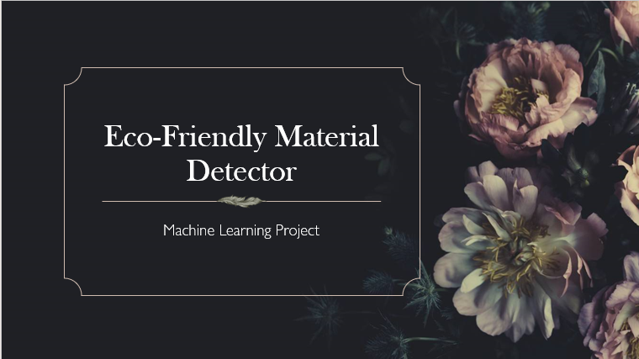

Slide 2
Introduction Text:
In today’s world, identifying environmentally safe materials is essential for promoting sustainable development. However, manually determining whether a material is eco-friendly often requires chemical expertise and access to regulatory databases.
This project proposes a machine learning-based solution to automatically classify materials as eco-friendly or not based on public data such as chemical descriptions and eco-certifications
We used trusted sources such as the U.S. EPA’s Safer Chemical Ingredients List (SCIL) and PubChem to gather information on various substances. By applying natural language processing (NLP) and classification algorithms, the system can predict the environmental safety of a material based on its properties and usage description.
Content:
The problem: Many modern materials are harmful to the environment, but it's hard to classify them manually.
Our solution: A machine learning model that automatically predicts whether a material is eco-friendly based on its properties and description.
Data sources:
  US EPA Safer Chemical Ingredients List (SCIL)
  PubChem Chemical Database
  Goal:
To build an intelligent, lightweight, and explainable tool that helps users — including students, researchers, and manufacturers — easily assess whether a material is environmentally safe.

Slide 3
: Understanding the Dataset :
:
Column Name | Description
Name | Common name of the material (e.g., Ethanol, PVC)
CASRN | Unique chemical identifier (CAS Registry Number)
Category | Label from EPA indicating eco-friendliness (e.g., Green Circle)
Label | Binary classification: 1 = Eco-Friendly, 0 = Not Eco-Friendly
Description | Short text summary from PubChem or EPA, includes material usage, toxicity, biodegradability, etc.
Toxicity | Text or categorical info (optional column) describing health/environmental hazards
Total entries collected: ~300+
Balanced between eco-friendly and non-eco-friendly materials.

Slide 4
Classification Model Overview:
ML Pipeline:
  Data Collection & Labeling (EPA SCIL + PubChem)
  Text Preprocessing (Cleaning descriptions)
  Feature Extraction: TF-IDF vectorization from text
  Classification: Logistic Regression / Random Forest
  Evaluation: Accuracy, Precision, Recall
Model Input:
  Text description of the material
Model Output:
  Predicted label: Eco-Friendly (1) or Not (0)
Example:
Test Material: Ethanol
Description: “Ethanol is a biodegradable, low-toxicity solvent used in cleaning products and cosmetics.”
Predicted Label: 1 (Eco-Friendly)
Actual Label: 1 ✅

Slide 5
Novelty and Applications:
Novelty:
Uses public chemical safety data + natural language descriptions for classification
Lightweight, interpretable, and explainable model
Requires minimal scientific/chemical knowledge to use.
Real-Life Applications:
Sustainable product development
Assisting manufacturers in choosing safe raw materials
Educational tool for eco-material awareness
Integration into procurement or inventory systems for material screening.
Future Scope:
Add image-based material recognition
Use Explainable AI (e.g., SHAP) to highlight why a material is classified one way

